Slide 1
Binary Heap :
Till now we have studied about trees and we are aware of complete binary trees.
Binary Heap is a binary tree only with the following properties:
1. It is a complete binary tree.(i.e. h = lg(n) )
2. Priority of child is either greater than parent OR
Priority of child is lesser than parent.

Slide 2
What is complete binary tree?
Complete binary tree is a binary tree where every level except the last one is full and the last level is filled up from left to right.
Height of tree = lg(n) --> ensured.

Slide 3
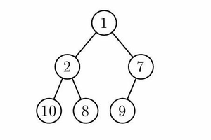
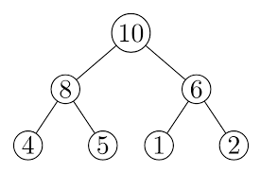
Types of heaps:
Min heap : value of parent < value of children.
Max heap : value of parent > value of children.
Max heap
Min heap

Slide 4
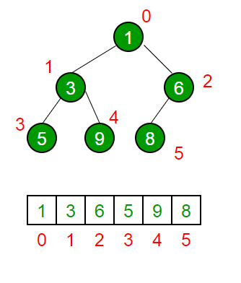
How to represent heaps?
Since heap is a complete binary tree, we can easily represent with help of ARRAY.
Parent --> i-th index
Left child --> (2* i + 1 ) th index
Right child --> (2*i + 2) th index

Slide 5
Why use array ?
Because access of child is easy with array.
We will fill the array till the position it is requried level by level. (level order filling)
It is possible because heap is a complete binary tree.

Slide 6
Insertion in Heaps:
We will insert the new element in such a way that after inserting the tree remains a complete binary tree. Although it would not be heap anymore.
To make it heap again we will do upheapify.

Slide 7
Deletion of peak in heap :
In order to maintain the complete binary tree property we will delete from the last.
Steps :
Swap 0th index and arr.size()-1
Pop the last element (which contains root now)
Now we have to do Downheapify.(to make it binary heap again)

Slide 8
Down heapify:
Time --> O( lg(n) )
Among parent , first child and second child ... whichever has max priority will become new parent(via swapping)

Slide 9
Build Heap unoptimised :
Given an array. Create heap from the array.
Simple approach:
We can mimic the insertion operation with some modifications in order to build heap from array.
How to think?
We will assume that if we are inserting i-th element then
till (i-1) it is already a heap.
Than we will insert i-th element and do upheapify....

Slide 10
Time complexity of this algorithm:
O(n * log(n) )

Slide 11
Can we do Better?
Yes ,we can ...
In the previous logic we were doing very less work for very less number of nodes and very heavy work for large number of nodes.
Now we will try to mirror this
i.e. more work for lesser number of nodes and less work for more number of nodes.

Slide 12
How can we achieve this?
By using down heapification, that we used for deletion.
We will start from last index and go till 0th index.
For every index we will check its children, if heap[current_indx] is smaller than the heap[children] we will swap and call function recursively on children.
Since last level will have more number of nodes which doesnt have children, implies less expensive operation for large no. Of nodes
And More expansive o/p for less no. Of nodes.

Slide 13
Build Heap (optimised) :
Time : O( n )

Slide 14
Delete any node from heap:
How??
Make the element to be deleted to max possible priority value and upheapify. ---> O ( lg(n) )
Then swap root with the last index --> O ( 1 )
The downheapify --> O ( lg(n) )
Overall time complexity == O ( log(n) )

Slide 15
Priority Queue...
Operations on priority Queue:
Insert
Delete
Get

Slide 16
Possible implementations :
1. Using unsorted Array:
Insert --> O( 1 )
Delete --> O(n)
Get --> O(n)
2. Sorted Array :
Insert --> O(n)
Delete --> O(n)
Get --> O(1)

Slide 17
Continued..
3. Unsorted List :
Inset --> O(1)
Delete --> O(n)
Get --> O(n)
4. Sorted List :
Inset --> O(n)
Delete --> O(n)
Get --> O(1)

Slide 18
Continued...
5. using BST :
Insert --> O(height) ( h != lg (n) ) // not always
Delete --> O(height)
Get --> O(height)
6. Binary Heap (BEST) :
It is complete binary tree Hence height will always be lg(n)
Insert --> O(lg(n) )
Delete --> O(lg(n) )
Get --> O(1)

Slide 19
Heap sort Idea...
Given an array sort it in ascending order.
Steps :
Make the array into maxheap.
Now swap 1st and last element and reheapify the array from 0->size-2
Then again swap 1st and new_last element and reheapify and virtuallly decrease size of array and reheapify....

Slide 20
Priority Queue STL :
priority_queue<int> pq;
// by default it is maxheap;
pq.push(num); // insert element into the queue.
pq.top(); // gives the top/root element.
pq.empty(); // return whether priority queue is empty or not.
pq.pop(); // delete the top element.

Slide 21
Continued...
How to change priority ?
priority_queue<int,vector<int>,greater<int> > pq;
// syntax for min priority queue;

Slide 22
Problems :
1. K-th largest element in a running stream.
2.join the ropes
statement :
given n ropes of different sizes, we are supposed to join the ropes together. The cost of joining 2 ropes of different sizes ‘p’ and ‘q’ is (p+q). Find the min cost in order to join all ropes to make one.

